Slide 1
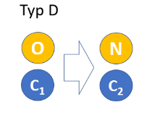
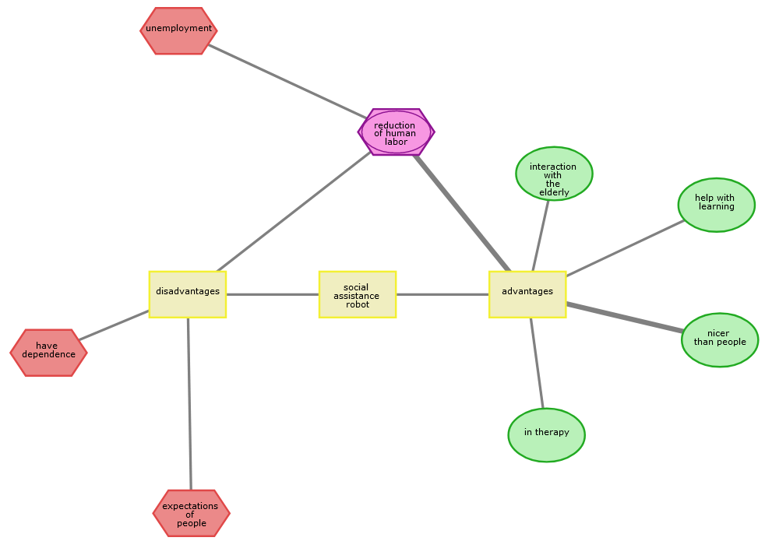
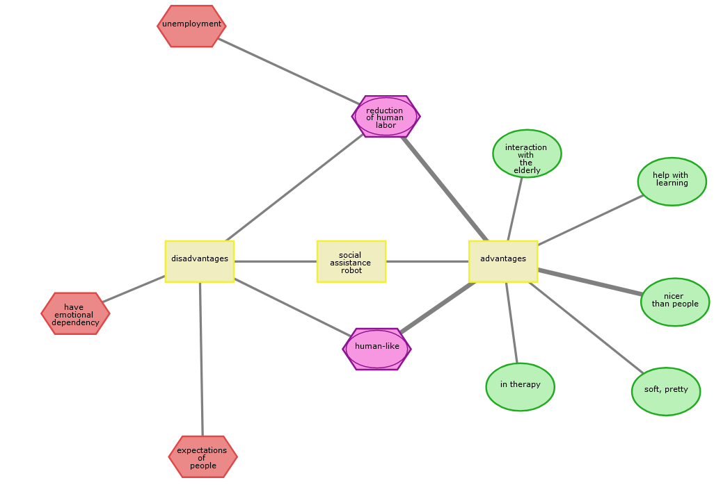
Rigid RR
Soft RR
Draw CAM
Adjust drawn CAM
Rigid SAR
Soft SAR
“old” (O)
“constant” (C1)
“constant” (C2)
“new” (N)

